Slide 1

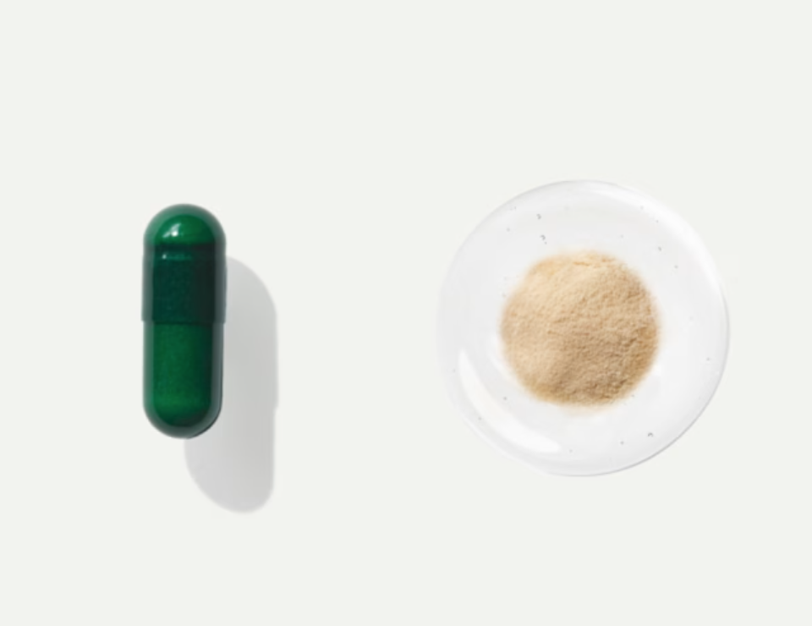
USABILITY STUDY
Viome
HCDE 517: Usability Studies
Prof. Sean Munson
Jan - Mar 2025
Team Members:
Jieqiong Ding, Abhay Sawhney, Julie Wang, Maggie Zhang
Notes:
Overview / Context
What’s the product
Who are the users
What are the usability problems to examine
Methods
Who did you test
where did you test, what methods did you use
what kinds of data did you collect
Results
Overview list
Problem & solution
Severity
Back-up data
Tentative solution?
Takeaways
What would we have done differently
What we’ve learned

Slide 2

Agenda
Background
Methods
Results
Takeaways
01
02
03
04

Slide 3
Background
01

Slide 4
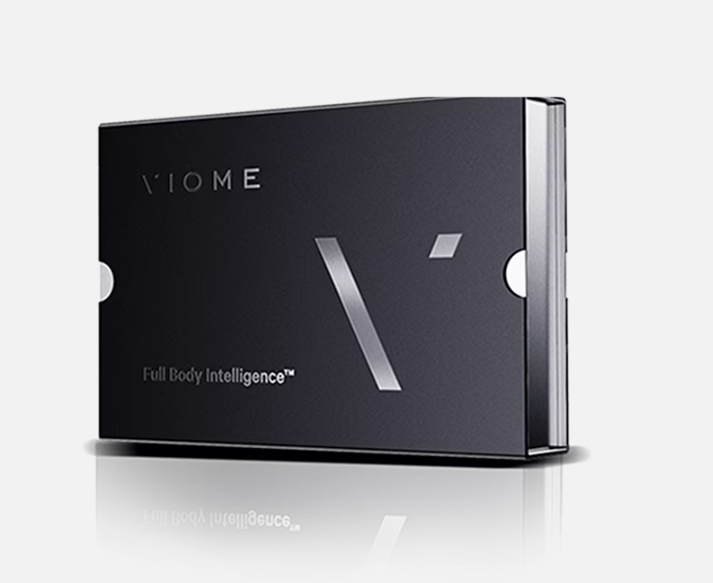
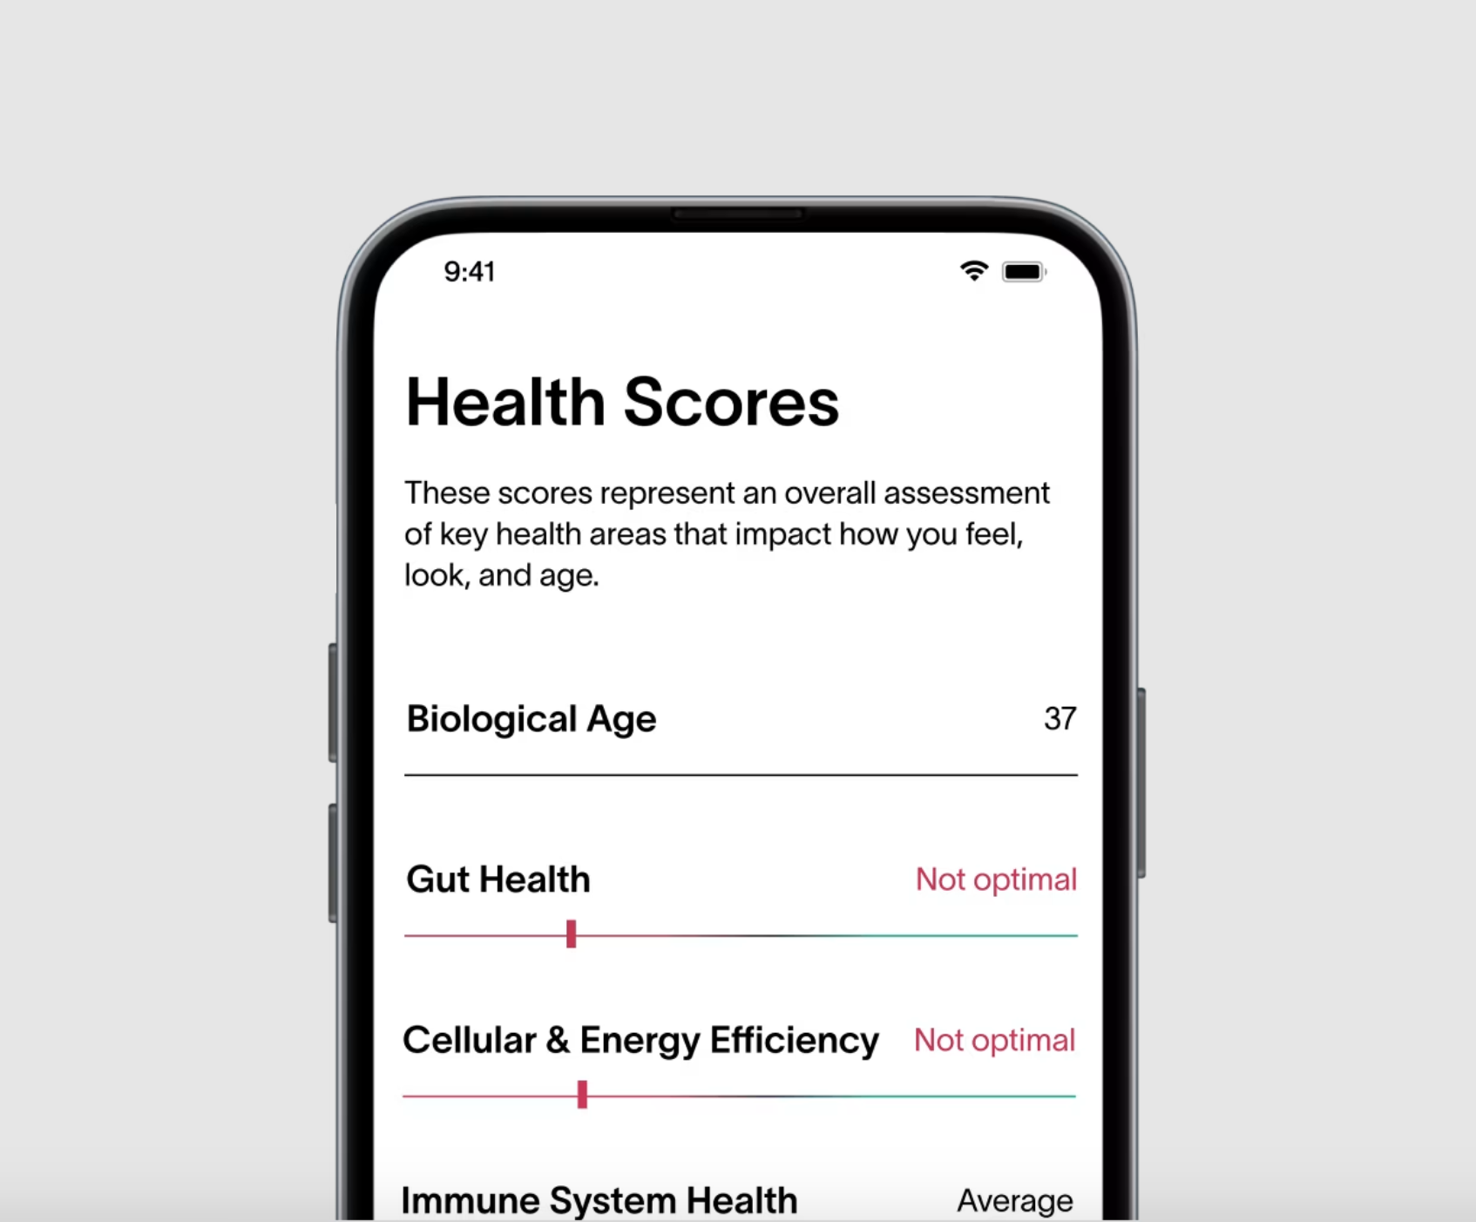
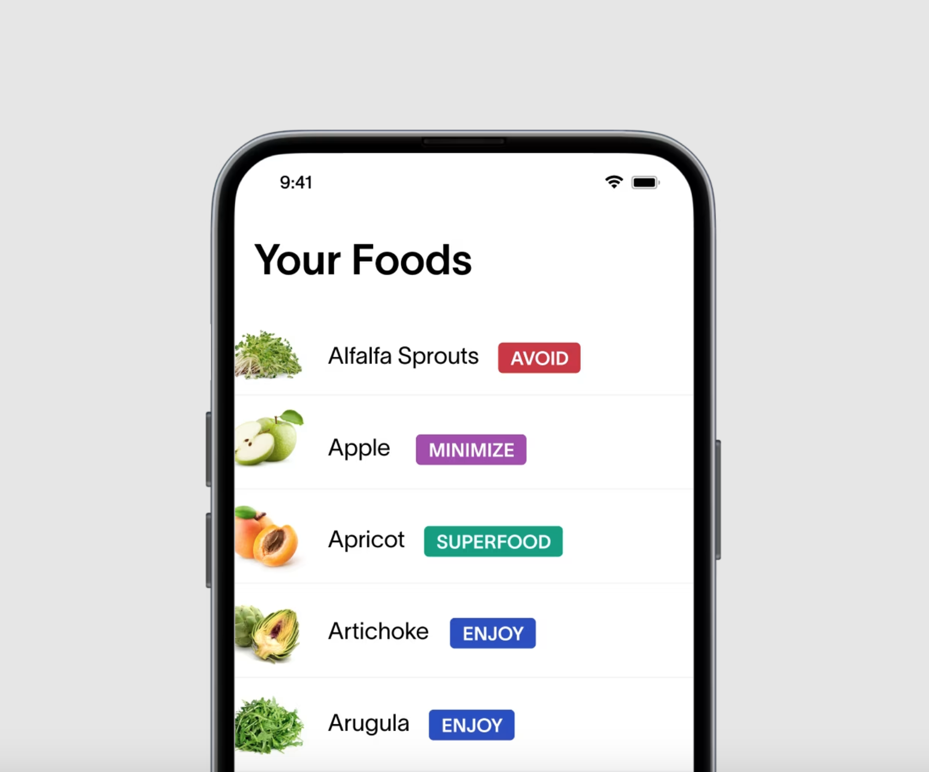
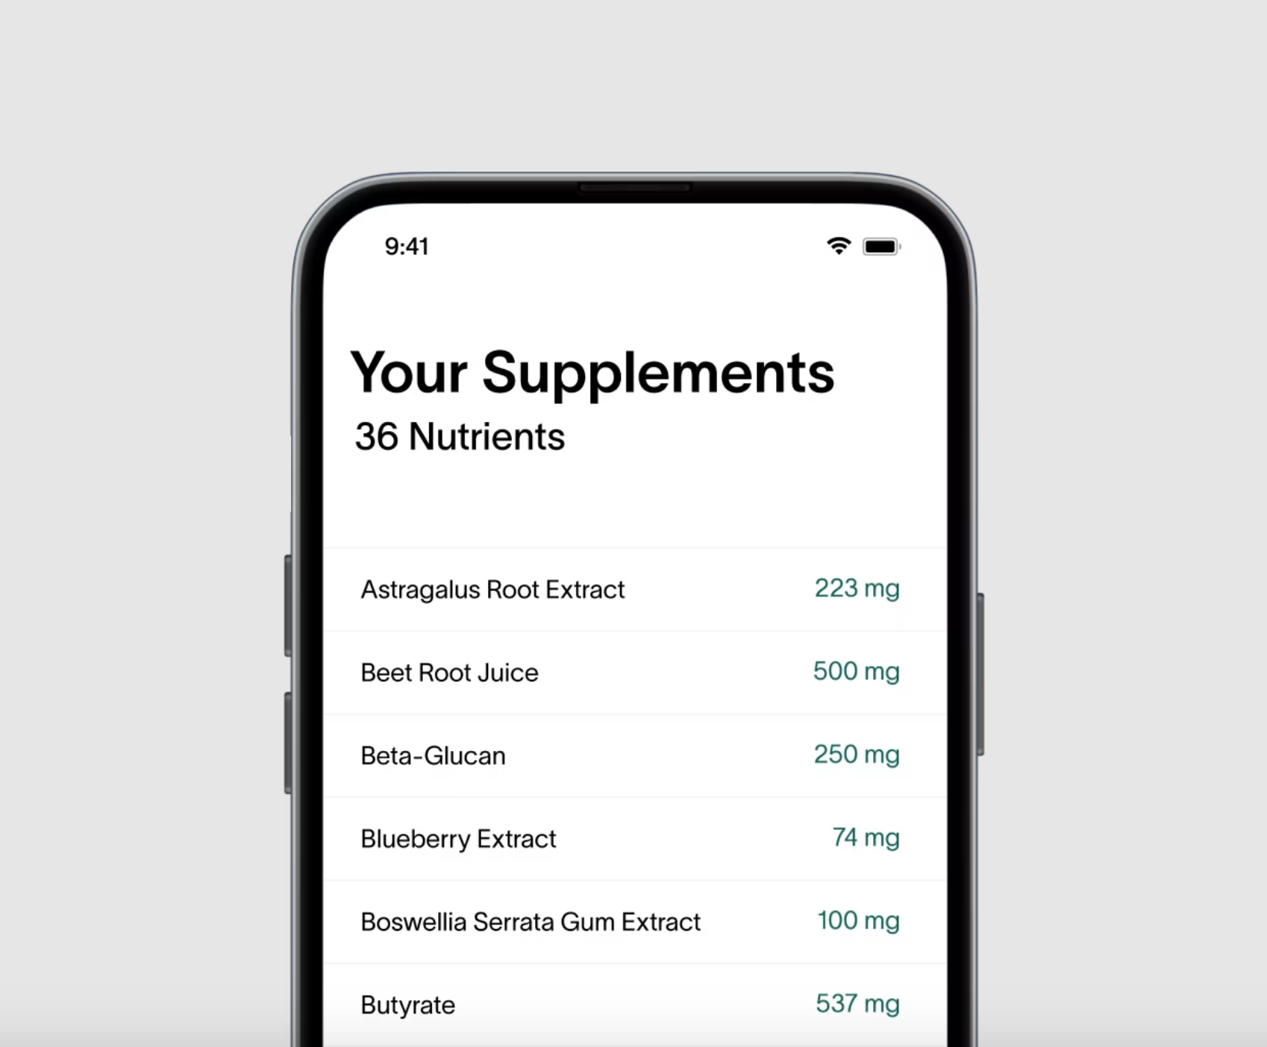

About the product
Viome is a health and wellness service that delivers at-home test kits, subscription-based wellness products, and personalized health recommendations for individuals who are looking to optimize their health or address current health issues.
Based on the results of the test kits (stool, blood, and saliva samples collected by users and sent to Viome), the company provides comprehensive health insights, via a mobile app, to help users objectively measure their health.
Notes:
Imagine you’re an otherwise healthy young working professional hat one day starts experiencing mysterious gut health issues. You decide to go to the doctor but might experience long times to get scheduled with a specialist. You feel you’re not getting a lot of information tailored to your lifestyle, and find yourself paying a lot of fees and hidden costs. Viome wants to change that. [Read]
From the comfort of your home, you can test using their Full Body Intelligence kit and receive results only 2-3 weeks later. Viome promises 50+ precision health scores and 370+ food recommendations via the mobile app to improve your health.

Slide 5
Target audience
Main user groups for the product fall into two main categories:
“Health optimizer”
“Health problem solver”
Young working professionals in their early to mid-thirties without any pressing health problems to address curious for ways to understand their health better and learn about preventative health practices
People with serious or more immediate health concerns looking for ways to improve their symptoms and restore their health
Notes:
Users generally fall into two categories, with “health optimizers” being young working professionals in their early to mid-thirties without any pressing health problems looking for preventative measures and a better understanding of their health and “health problem solvers” being people with serious or more immediate health concerns looking for ways to manage symptoms and restore their health.

Slide 6

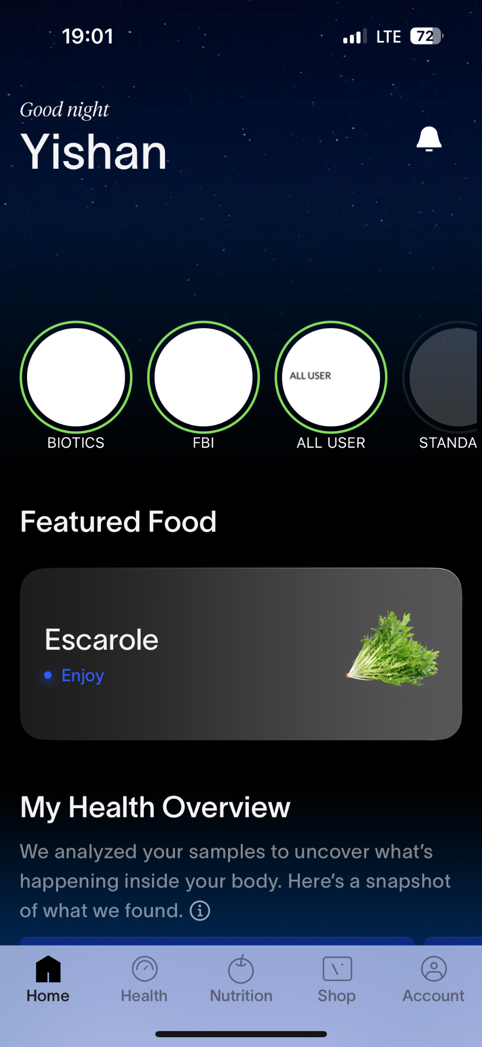
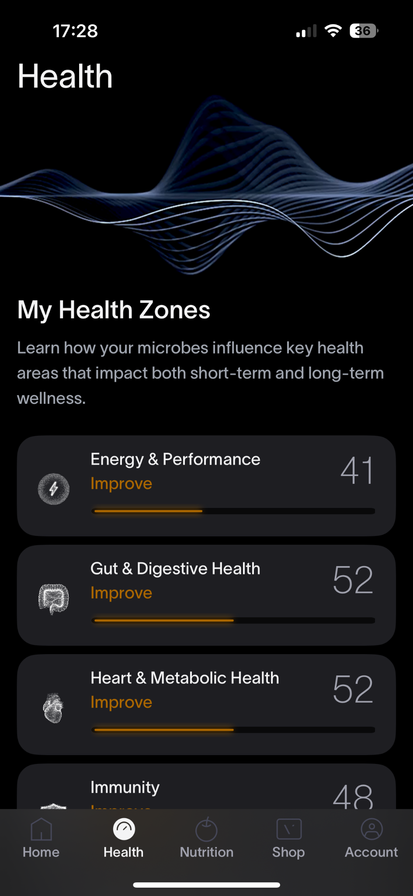
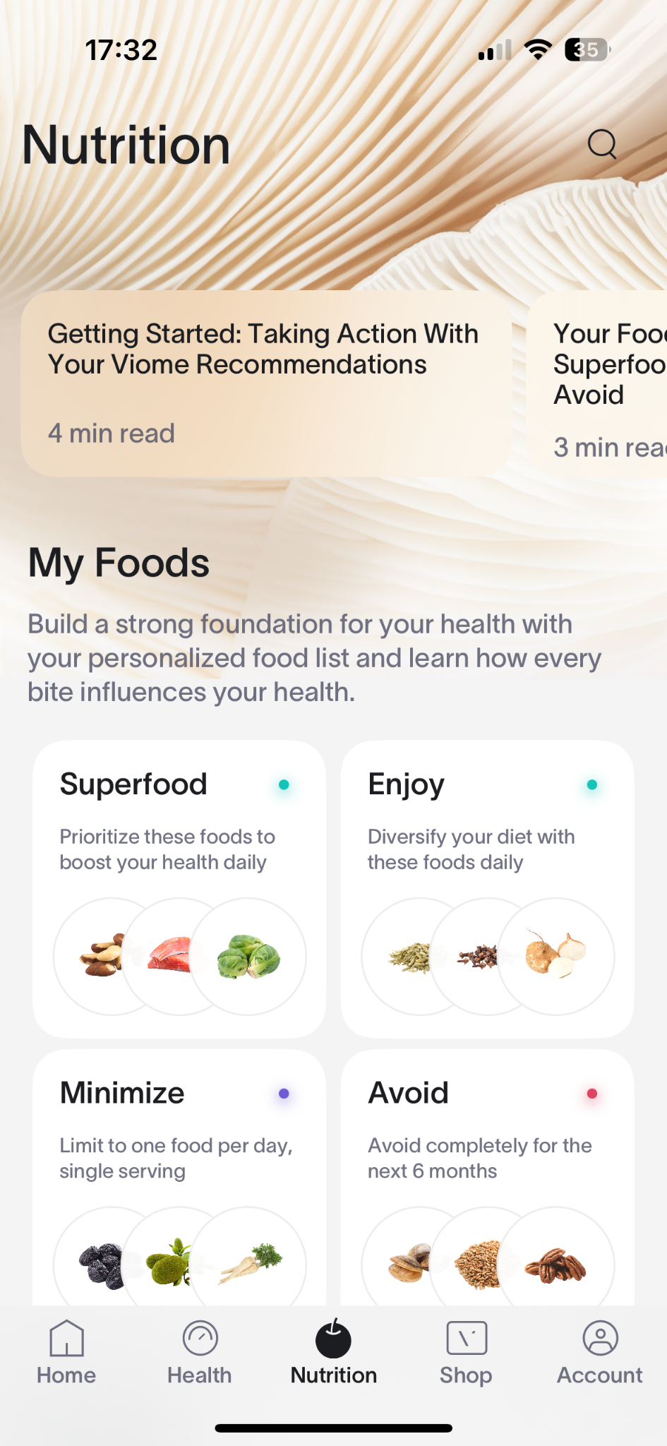
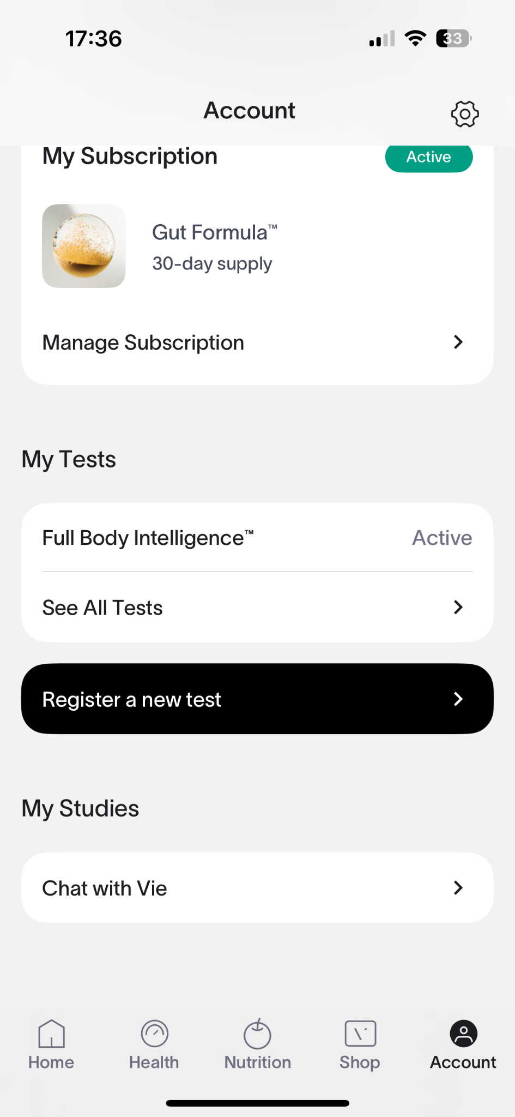
Study scope
Due to the time and logistical constraints of this project as well as the client’s desire to test the new version of the mobile app, we decided to focus only on the post-test, mobile user flow.
Within the app, we focused on these pages:
Notes:
Throughout the project, we worked with Susan Zheng, a senior designer and Kevin Woo, the director of Design. When we initially reached out, Susan and the design team were about to launch a new version of the Viome app. Their goals were seeing whether the new app improved information overload, exploring new feature ideas, and improving user retention and conversion rates. For our study, we decided to focus on the mobile user flow as that was the most frequently used entrypoint for the Viome experience, and due to time and logistical constraints, we studied only the new version of the app. The app consists of 3 main flows: the Home, Health, and Nutrition page. Due to HIPPA compliance reasons during the study, users were shown a test account with test data and asked to imagine scenarios where they were a health optimizer or health problem solver.

Slide 7
Research goals
Based on discussion with the client, we aligned on testing for the following goals:
1
2
3
4
5
Understanding
Actionability
Ease of navigation
Engagement & satisfaction
Future enhancements
Do users clearly understand their health scores?
Can users determine appropriate actions based on their test results?
How intuitive is it for users to navigate the app and find relevant information?
What features encourage continued use over time? What helps users develop trust in the product?
What additional features or product improvements would users expect to see?
Notes:
Our research goals were understanding whether 1) information overload had improved, 2) explore new feature ideas, and 3) improve the likelihood of user retention and conversion to purchase additional products from Viome. We translated these 3 ideas into 4 major areas of understanding: 1) understanding & actionability, 2) ease of navigation, 3) engagement & satisfaction, and 4 future enhancements.

Slide 8
Methods
02

Slide 9
Who we tested with
8 total participants; users were screened for age (25+) and employment status (full-time employed). Based on their responses, users were then categorized against two attributes–health motivations and familiarity with Viome.
Health optimizers (6)
Health problem solvers (2)
Proactive about health and wellness, interested in personalized nutrition and preventative care
Motivated by immediate health concerns, seeking actionable insights to improve well-being
Returning users (4)
New users (4)
Have completed a Viome health test and have been using the app for at least 1-2 months
Have never seen or used the Viome test and app
Notes:
We had 8 total participants. Based on the target user demographics, a user would receive a screener survey that asked questions about their age, employment status, availability, familiarity with Viome, and whether they had any health conditions. They were then grouped into four major categories: health optimizers or health problem solvers and returning vs. new users.

Slide 10
How we tested
Online
In-person
How: Using the participant’s desktop device to access an interactive Figma prototype of the app
Where: Remote, on Zoom (participants were not required to be based in the Seattle area)
How: Using the moderator’s mobile device and a test account for the TestFlight version of the app
Where: Various locations in the Seattle area, optimizing for quiet space
All sessions were in a moderated format using the Think-Aloud Protocol and included both a pre-test questionnaire and post-test questionnaire
Notes:
A little bit about the format. During the study, we hosted sessions both online and in-person over the course of 2 weeks. For online sessions, the participant was asked to connect via Zoom and use a laptop computer to screen share their interactions with the Viome app through a Figma prototype. Online participants could be located across the United States.
For in-person sessions, we used a TestFlight version of the app on the moderator’s mobile device and recorded the participant’s interactions via screen recording and a separate camera for their real-time responses to usability task questions.
For new users, we made sure to educate them by showing an informational video of the Viome experience and a real testing kit and allowing them to ask any clarifying questions before getting started.
All sessions had the same tasks and questions, with a pre-test questionnaire at the beginning, a post-test questionnaire at the end, and moderation using the Think-Aloud Protocol.

Slide 11
Data collected
Qualitative
Quantitative
Comments from screening/background survey
Interview quotes
User-generated content based on interviews* and community Facebook group analysis
Self-reported ratings (on a Likert scale) through pre-test and post-test questionnaires
Time to task completion
Number of clicks to task completion
Do users clearly understand their health scores?
Can users determine appropriate actions based on their test results?
How intuitive is it for users to navigate the app and find relevant information?
What features encourage continued use over time? What helps users develop trust in the product?
What additional features or product improvements would users expect to see?
*Only collected from one new user due to technical limitations
Notes:
We collected a range of qualitative and quantitative data from the study, including comments from the screening/background survey, quotes, Facebook group posts, self-reported ratings, time to task completion, and number of clicks to task completion. For the purpose of the presentation, we’ll focus on the qualitative data today.

Slide 12
Results
03

Slide 13
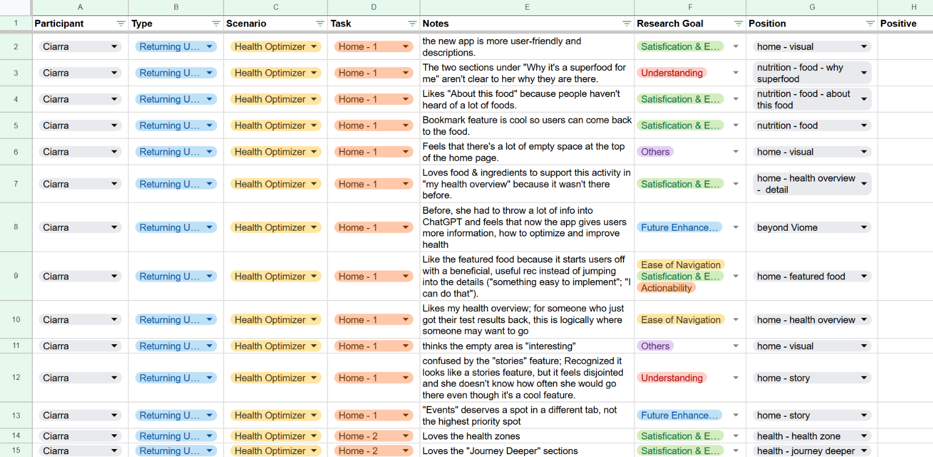
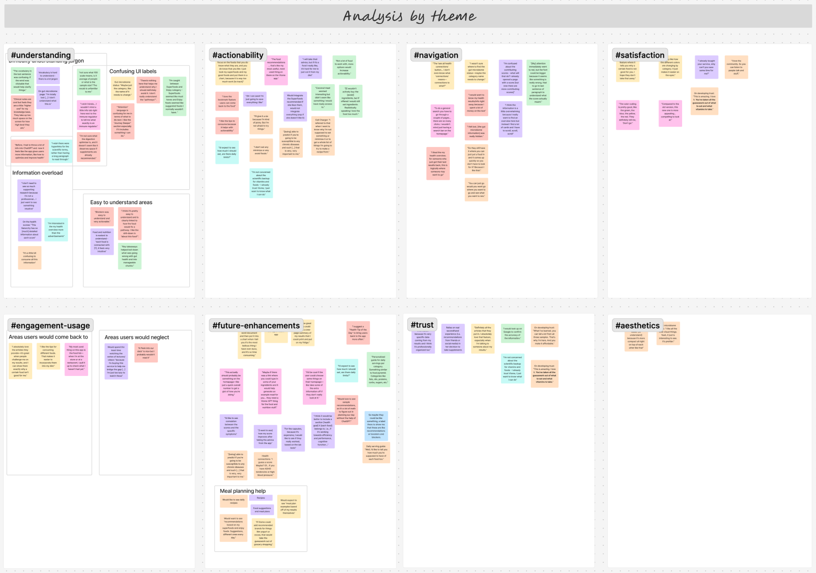
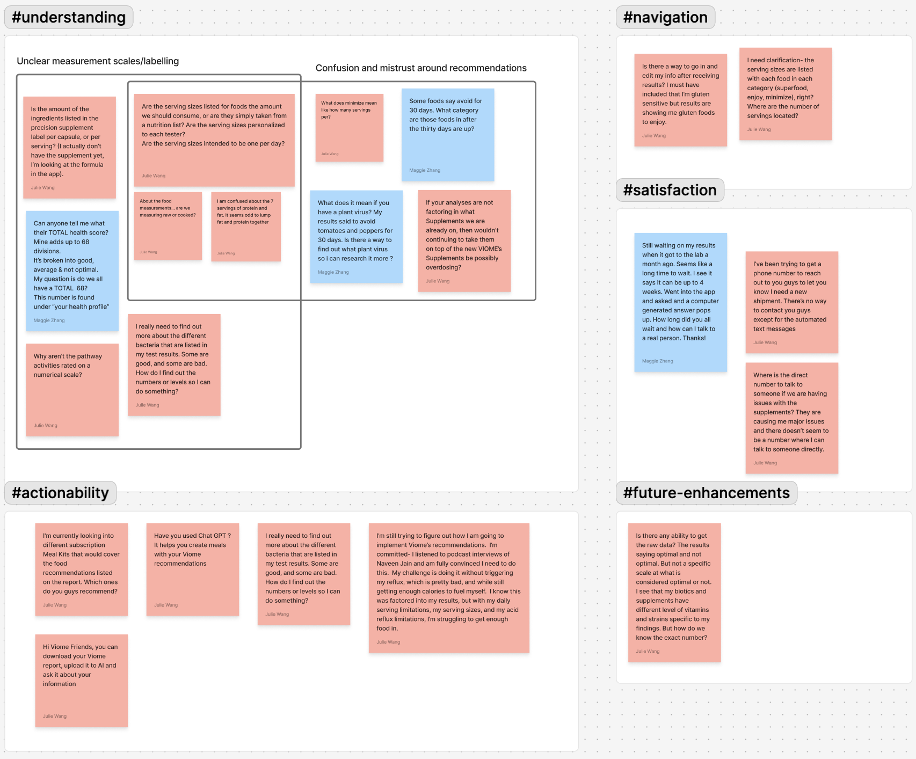
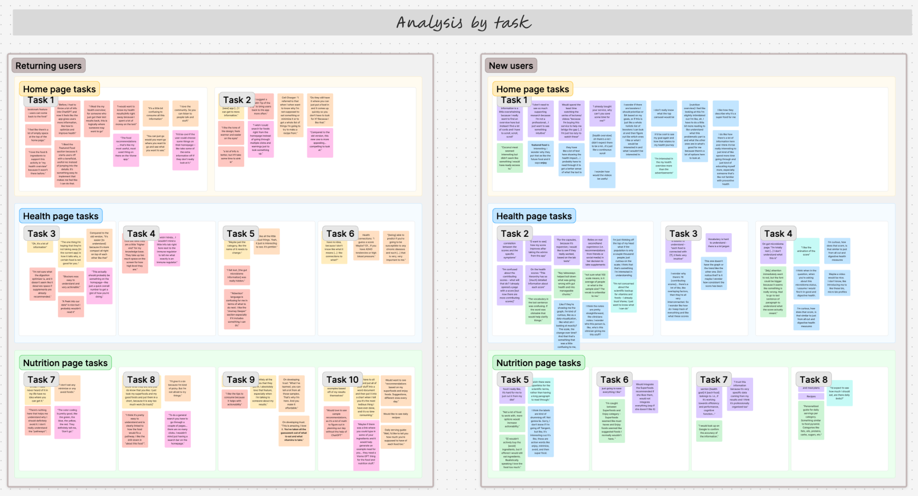
Data analysis process
Thematic Analysis
Affinity Diagramming
Community Post Analysis
We sorted notes into codes relating to research goals, i.e. understanding, actionability, ease of navigation, and future enhancements
Usability task responses per user were derived from recordings and categorized by task and user type and mapped based on themes.
We reviewed the last 30 days (2/6-3/7) worth of posts on the Viome Community Facebook page and categorized user sentiments into categories aligned to our research questions

Slide 14
Evaluation of issue priority
Low
Medium
High
Minor navigation challenges
Visual layout preferences
Minor trust concerns
Areas where users find their own workarounds
Lack of connection between recommendation and action
Discourages user from coming back to the app
Discourages user from making future purchases
Major trust concerns
Low
Number of user quotes,
Time / number of clicks to task completion
High
Notes:
Low Severity Issues
Minor navigation challenges (e.g., small learning curve for new users)
Visual layout preferences (e.g., preference for a cleaner UI but not a blocker)
Minor trust concerns (e.g., some users wanted more citations but still found the content credible)
Medium Severity Issues
Understanding of Gut Microbiome Scores (some users needed clearer explanations)
Actionability of recommendations (users found adding foods easier than eliminating them)
High Severity Issues
Difficulty in locating key features (some struggled to find detailed health insights easily)
Home page cognitive load (some users felt overwhelmed by the amount of information)

Slide 15
Findings at a Glance
84 user quotes were coded and grouped into 5 major themes
11%
(11/84)
14%
(12/84)
⬤ Understanding
⬤ Actionability
⬤ Navigation ⬤ Satisfaction & Engagement ⬤ Future Enhancements
25%
(21/84)
29%
(24/84)
19%
(16/84)
Notes:
This is how user responses contribute to insights on the five research goals.
242
Understandability 117
Actionability 32
Navigation 59
Satisfaction 58
Future 16

Slide 16
3-1
Understanding
⬤ Health Optimizers wanted deeper insights ⬤ Health Problem Solvers needed clearer cause-and-effect explanations ⬤ New Users found the content a bit overwhelming and jargon-heavy ⬤ Returning Users appreciated the improved visual clarity
Notes:
When we looked at understanding and accessibility across user groups, we saw different needs:
Health Optimizers wanted deeper insights—they understood the recommendations but wanted more scientific backing and connections to long-term health.
Health Problem Solvers needed clearer cause-and-effect explanations, as some struggled to understand how recommendations linked to their symptoms.
New Users found the content a bit overwhelming and jargon-heavy, making it harder to interpret their results without extra guidance.
Returning Users appreciated the improved clarity in this version of the app compared to the older one, signaling progress in accessibility.

Slide 17
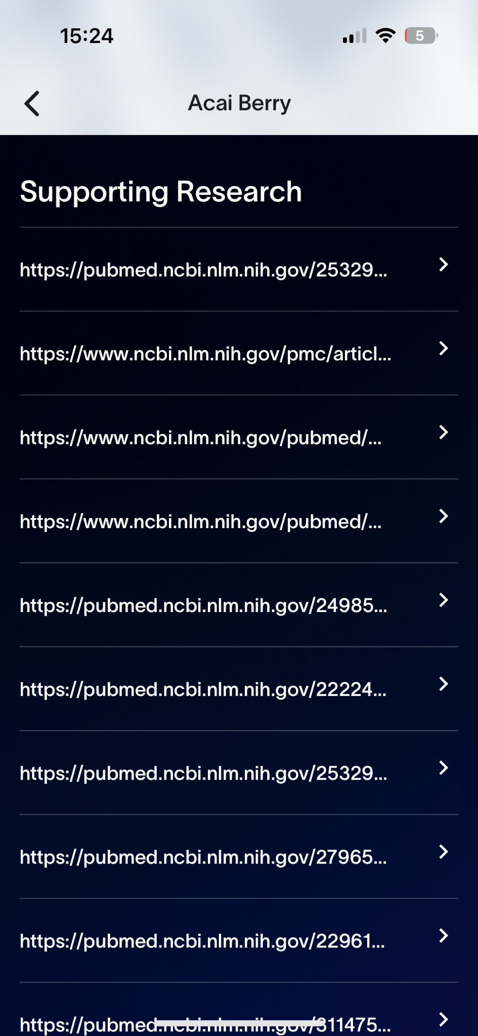
Information Overload
High
“I don’t need to see so much supporting research because I’m not a professional... I just want to see something intuitive”
Evidence:
All new users and 3 of 4 returning users mentioned there is too much information. Recommended solution:
Avoid long paragraphs. Breaking up paragraphs into bullet points and lists.
Prioritize more actionable recommendations than scientific reasoning.
All User Types

Slide 18
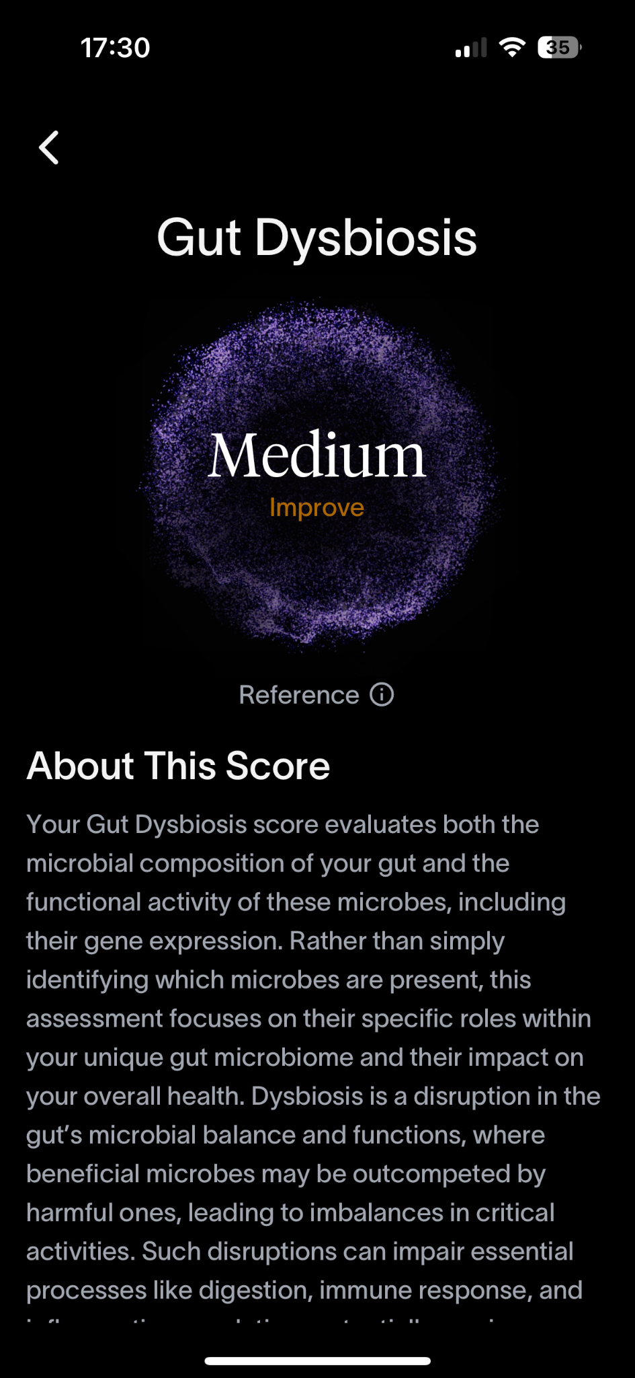
Complex Jargons
Medium
“I wouldn’t mind a little info tab right here next to the immune regulator to tell me what exactly is an immune regulator.”
Evidence:
6 of 8 participants expressed difficulty understanding jargons and scientific terms, which made them confused about the scores and recommendations.
Recommended solution:
Avoid unnecessary jargons. Speak the user’s language.
Add hyperlinks on important terms so that users can refer to them when necessary.
All User Types
Notes:
Issue
Position
Evidence
Quotes
Recommendations

Slide 19
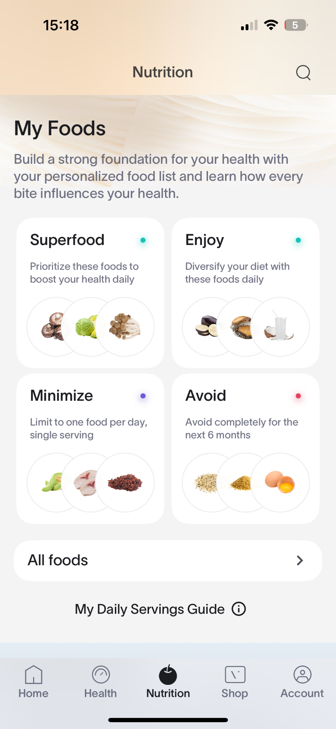
Confusing labels
Low
“I’m caught between Superfoods and Enjoy category - Superfoods seemed like must haves and Enjoy foods seemed like suggested foods I normally wouldn't have. “
Evidence:
3 new users expressed confusion over “superfood,” which is a noun compared to other action verbs.
Recommended solution:
Avoid unnecessary jargons. Speak the user’s language.
Add hyperlinks on important jargons and terms so that users can refer to them when necessary.
New User
Notes:
Issue
Position
Evidence
Quotes
Recommendations

Slide 20
3-2
Actionability
⬤ Health Optimizers preferred clear connections between foods and health. ⬤ Health Problem Solvers expected tips on integration of food into meals. ⬤ New Users needed guidance on prioritizing recommendations. ⬤ Returning Users desired more customization and visualized guidance.
Notes:
When we looked at understanding and accessibility across user groups, we saw different needs:
Health Optimizers wanted deeper insights—they understood the recommendations but wanted more scientific backing and connections to long-term health.
Health Problem Solvers needed clearer cause-and-effect explanations, as some struggled to understand how recommendations linked to their symptoms.
New Users found the content a bit overwhelming and jargon-heavy, making it harder to interpret their results without extra guidance.
Returning Users appreciated the improved clarity in this version of the app compared to the older one, signaling progress in accessibility.

Slide 21
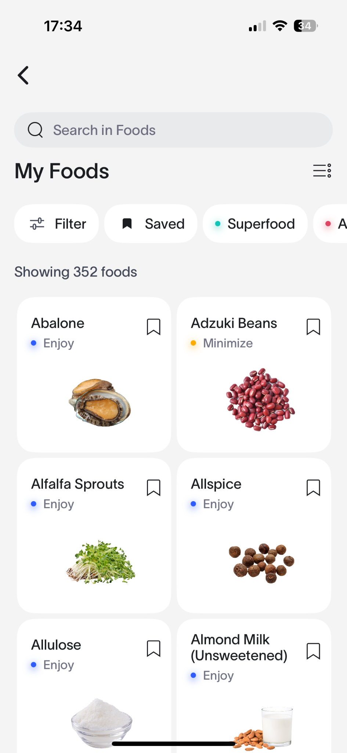
Hard to prioritize recommendations
Medium
“If the avoid food is connected with my primary health goal like sleeping issues, I would cut it off even if it’s my favorite food.”
Evidence:
All new users and 3 of 4 returning users mentioned it would be hard to follow all of the suggestions because of food access, personal preference, and health goal severity.
Recommended solution:
Link the food to the users’ health goals.
Present users with prioritization of food instead of presenting a plain list.
All User Types
Notes:
Issue
Position
Evidence
Quotes
Recommendations

Slide 22
3-3
Ease of Navigation
⬤ Health Optimizers had little to no trouble navigating ⬤ Health Problem Solvers appreciated the visual clarity
⬤ New Users were overwhelmed by the amount of information ⬤ Returning Users generally liked the more structured layout
Notes:
Navigation experiences also varied across groups:
Health Optimizers had no trouble navigating but wanted faster access to advanced health insights instead of general overviews.
Health Problem Solvers occasionally struggled to locate specific health scores and recommendations, though they appreciated the visual clarity once they found them.
New Users were overwhelmed by the amount of information and needed better onboarding to understand where to start.
Returning Users generally liked the more structured layout but mentioned they missed some shortcuts from the previous version.

Slide 23
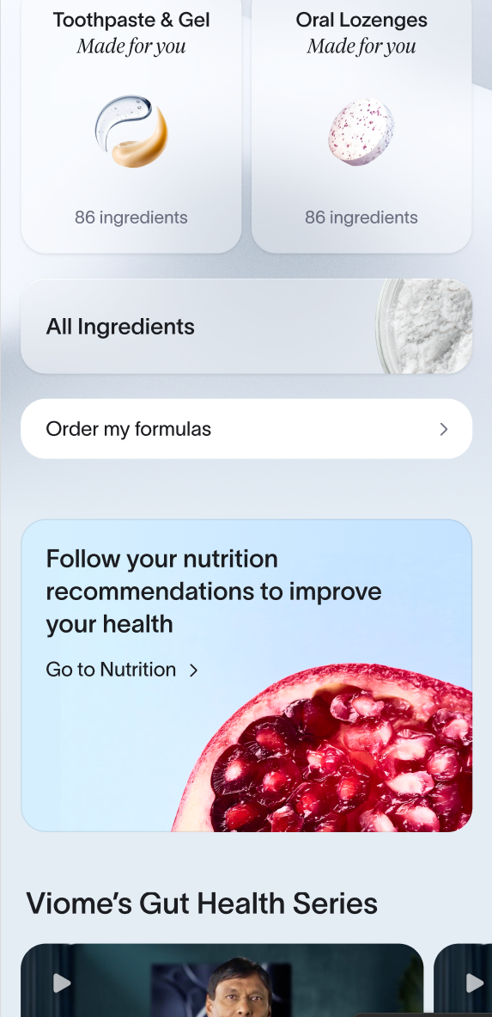
Home page length
Medium
“There’s just a lot happening on this page—I wasn’t sure where to start or what was most important.”
Evidence:
2 new users mentioned they didn’t know how to proceed.
Recommended solution:
Clear starting point/onboarding flow for new users
New user
Notes:
Issue
Position
Evidence
Quotes
Recommendations

Slide 24
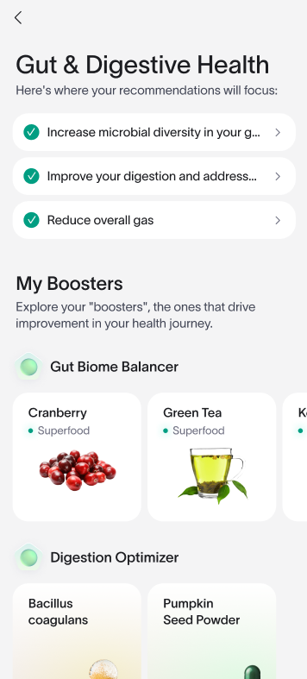
Locating key health data
Medium
"It took me a minute to find my gut health score, but once I saw the color-coded sections, it made sense."
“I felt lost, [the gut microbiome information] was really hidden.”
Evidence:
2 existing users and 1 new user encountered this issue.
Recommended solution:
Easier navigation from home page for key user journeys
All user types
Notes:
Issue
Position
Evidence
Quotes
Recommendations

Slide 25
3-4
Engagement & Satisfaction
⬤ Health Optimizers engaged deeply with personalized insights ⬤ Health Problem Solvers appreciated the actionable steps ⬤ New Users are interested in health data more than promotional content ⬤ Returning Users were overall happier with the new version
Notes:
For engagement and satisfaction, different user types had distinct preferences:
Health Optimizers engaged deeply with personalized insights but wanted long-term trend tracking to understand progress over time.
Health Problem Solvers appreciated the actionable steps but sometimes felt they needed more reassurance about the effectiveness of recommendations.
New Users found the app interesting but needed clearer explanations to stay engaged beyond their initial use.
Returning Users were happier with the new version but still saw opportunities for small refinements in usability and navigation.

Slide 26
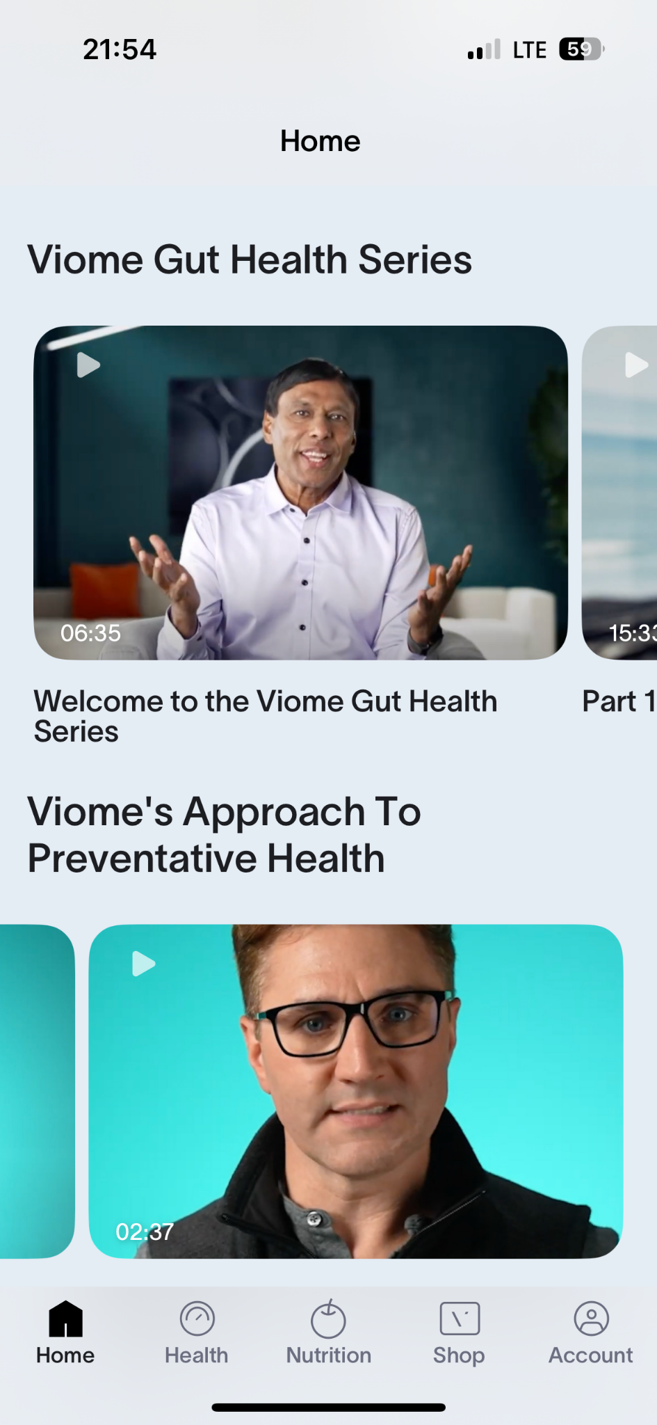
Lack of interest in promotional content
Low
“I’m interested in the my health overview more than the advertisements.”
Evidence:
75% (3 out of 4) of new users mentioned that the videos embedded in the app would be the feature they expect to engage with least, and don’t view them as key resources
Recommended solution:
Deprioritize video content from prime digital real estate on the home page, but continue to host videos in the “Health” page for those who want to dive deeper
New user
Notes:
Issue
Position
Evidence
Quotes
Recommendations

Slide 27
3-5
Future Enhancements
⬤ Health Optimizers would benefit from trend-tracking features ⬤ Health Problem Solvers need stronger connections between symptoms and solutions ⬤ New Users would benefit from a structured walkthrough or guide ⬤ Returning Users liked the new structure but missed some familiar shortcuts
Notes:
Based on our findings, here are the future enhancements tailored to each user group:
Health Optimizers would benefit from trend-tracking features and deeper insights to help them see long-term health changes over time.
Health Problem Solvers need stronger connections between symptoms and solutions, making recommendations more intuitive and actionable.
New Users would benefit from a structured walkthrough or guide to ease their onboarding experience.
Returning Users liked the new structure but missed some familiar shortcuts, so bringing back key navigation features from the old version while keeping improvements would help retention.

Slide 28
Lack of Personalized Food Recommendations and Plans
Medium
“Would love to see sample recommendations, as it's a lot of math to figure out in planning our day without the help of ChatGPT"
"If Viome could add recommended brands for things like coconut yogurt or cocoa, that would take the guesswork out of grocery shopping."
Evidence:
7 out of 8 users (87.5%) indicated desire for personalized guide or food plan based on user’s recommended and saved foods
Recommended solution:
Integrate tools for users to create food plans, get information on daily servings, or find recipes to consume their recommended foods
All User Types
Notes:
Issue
Position
Evidence
Quotes
Recommendations

Slide 29
More Connection Between Foods or Supplements Recommended and Health Score
Medium
“For the capsules, because it’s expensive, I would like to see if they really worked, based on the lab tests”
“[I want to see] how my score improves after taking the advice from the app”
Evidence:
2 out of 4 returning users and 1 new user (37.5%) indicated a desire to see correlation or causation after taking advice for food recommendations or capsules
Recommended solution:
Option to see crowd-sourced data on improvements after taking supplements or changing diet
Options to track self-reported health data after taking supplements or changing diet
All User Types
Notes:
Issue
Position
Evidence
Quotes
Recommendations

Slide 30
Viome Facebook Group Analysis
14%
23%
4%
9%
Overview of most commonly mentioned topics
50%
⬤ Understanding
⬤ Actionability ⬤ Satisfaction ⬤ Navigation
⬤ Future Enhancements

Slide 31
Viome Community Facebook Group Analysis
22 usability-related comments were collected from posts over the course of 30 days from February 6 and March 7, 2025 and grouped by themes
Understanding (50%)
Actionability (23%)
Satisfaction (14%)
Confusion around measurement of supplements and serving size recommendations (7 comments)
Improper labelling and/or difficulty understanding health scores (3 comments)
Need help on meal plans based on food recommendations (3 comments)
Need help taking action on more niche data (2 comments)
Trouble finding a direct number to talk to “real person” (3 comments)
Navigation (9%)
Future Enhancements (4%)
Need help editing personal info for tailored recommendations (1 comment)
Need help on finding serving recommendations (1 comment)
Requesting raw data for optimal and non-optimal results (1 comment)

Slide 32
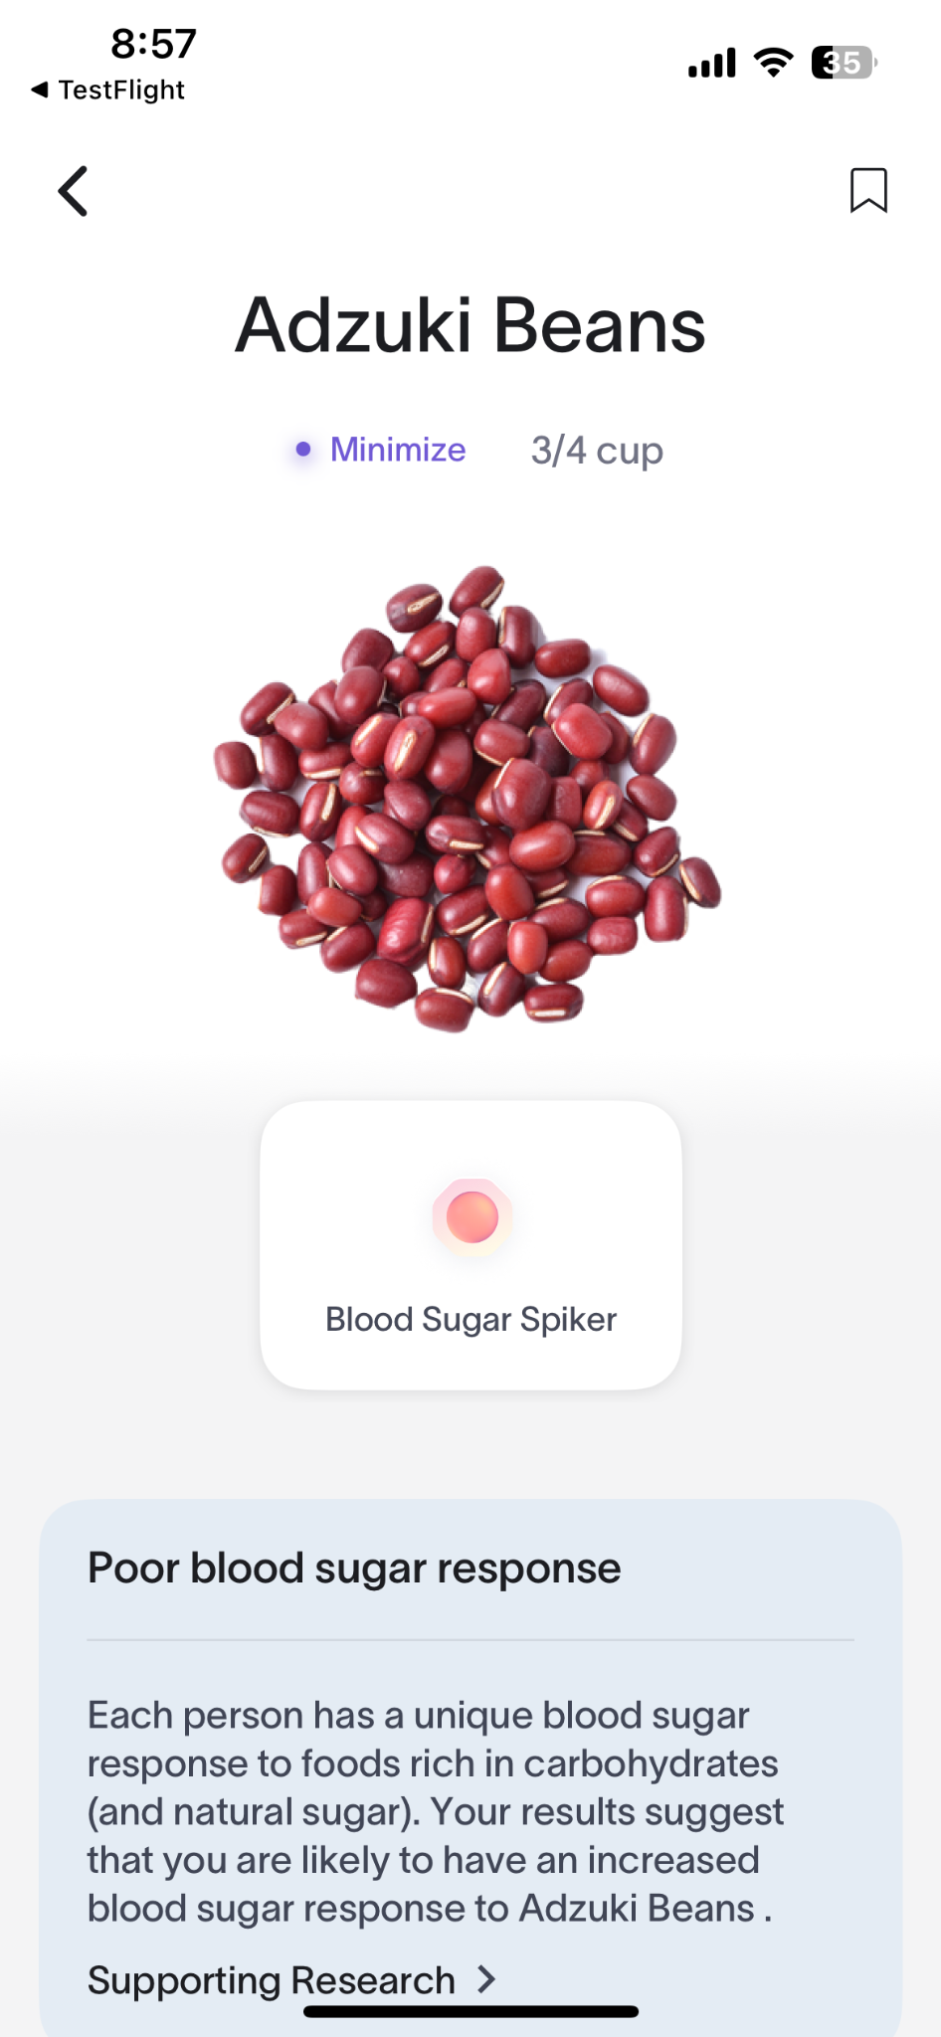
Clarification needed in recommended amounts
Medium
“Are the serving sizes listed for foods the amount we should consume, or are they simply taken from a nutrition list? Are the serving sizes personalized to each tester?”
Evidence:
The majority of usability-related comments (7 from the past 30 days) were related to help needed on understanding food or supplement measurements
Recommended solutions:
Increase specificity to UX copywriting (i.e. “limit consumption to 3/4 cup of cooked adzuki beans each week…”)
Allow users to input and track the amount of “Minimize” foods they’ve consumed directly in the app
Returning user
Notes:
Issue
Position
Evidence
Quotes
Recommendations

Slide 33
Takeaways
04

Slide 34
What we would have done differently
Due to technical limitations we weren’t able to show the old and new versions of the app side by side, but would have loved to do some A/B testing to more clearly measure the impact of the new design
There were minor differences in the Figma prototype and TestFlight version of the app; we would have benefited from more data consistency if we tested with one version across the user groups

Slide 35
What we learned from this project
Working in a startup environment means being agile and adaptable
Users don’t always instantly know what they’d expect out of an experience; co-design requires a degree of technical aptitude and preparation
Testing with health data can be tricky; when users can’t test with their own data, it’s important to make sure they’re motivated by a believable scenario

Slide 36
Thanks!
Questions?
Special thanks to:
Susan Zheng, Kevin Woo, and Lisa Shomo

